Slide 1
Each presentation must be no longer than 3 minutes. Presentations will be stopped after 3 minutes.
One static PowerPoint slide is allowed. No transitions, animations, or builds.
No additional media (e.g., audio or video files) or props (e.g., equipment, costumes) are allowed.
The presentation must be delivered in spoken word only – no poetry, rapping, or singing.
Presentations should be delivered in English.
The content must be the presenter’s original research.
The aim is to make your research clear, engaging, and understandable to a non-specialist audience.
3-minute presentation challenge - Rules

Slide 2
The presentation can have only 2 slides – an Introduction slide and a research content slide
Introduction slides should only have the research title, your name and affiliation
Research and presentation context on Slide 2
You have to follow the given template and submit the presentation on 12th May for screening.
3-minute presentation challenge - Guidelines

Slide 3
Increasing mind wandering with accelerated
intermittent theta burst stimulation
Steffen Rygg Aasen, Department of Psychology

Slide 4

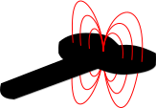

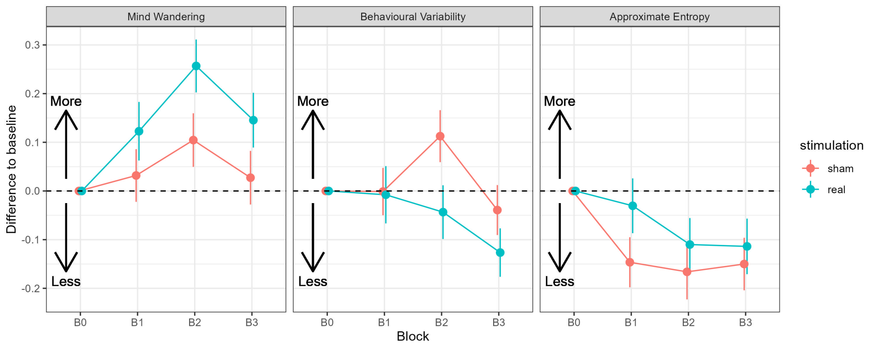
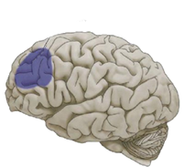




Increasing mind wandering with non-invasive brain stimulation
To what degree were you focused on the task just before this question?
+
Illustrations from pixabay & ChatGPT
Notes:
Mind wandering is a phenomenon most of us are familiar with. It is characterized by a shift of attention away from what we are currently doing to interal thoughts, and has a tendency to occur despite your best effort to stay focused on a task – for instance, thinking about food during an exam.
It is still not entirely clear what causes us to mind wander, but a region in the front of the brain has been associated with mind wandering. To directly test whether this region is implicated in mind wandering, we decided to implicate this region, we
- Used TMS
- (boring) Attention task (making people MW)
- double blinded within-subject crossover sham-controlled design
- We found that real stimulation, compared to sham stimulation, indicated more MW, directily implicating the prefrontal cortex in Mwas

